Slide 1
Matrix analysis results share!
11 Aug 2020

Slide 2
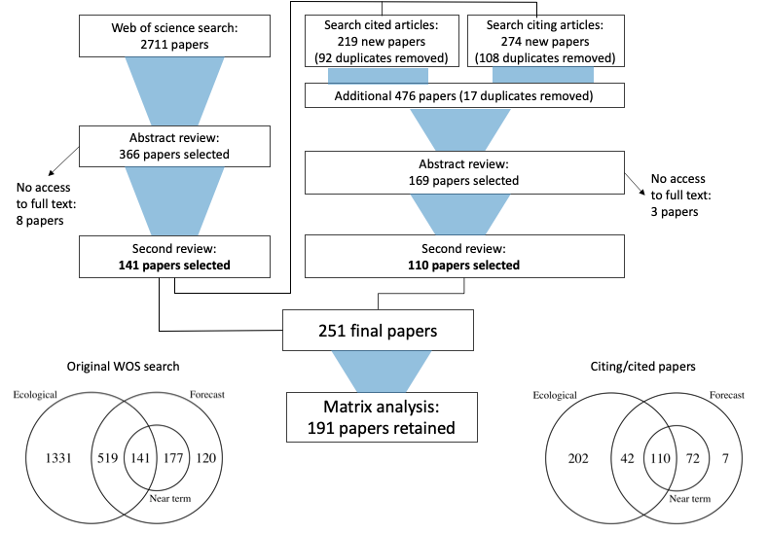
Figure 1: Systematic literature review. Venn diagrams illustrate the number of studies that met each of our three criteria after two rounds of review.

Slide 3
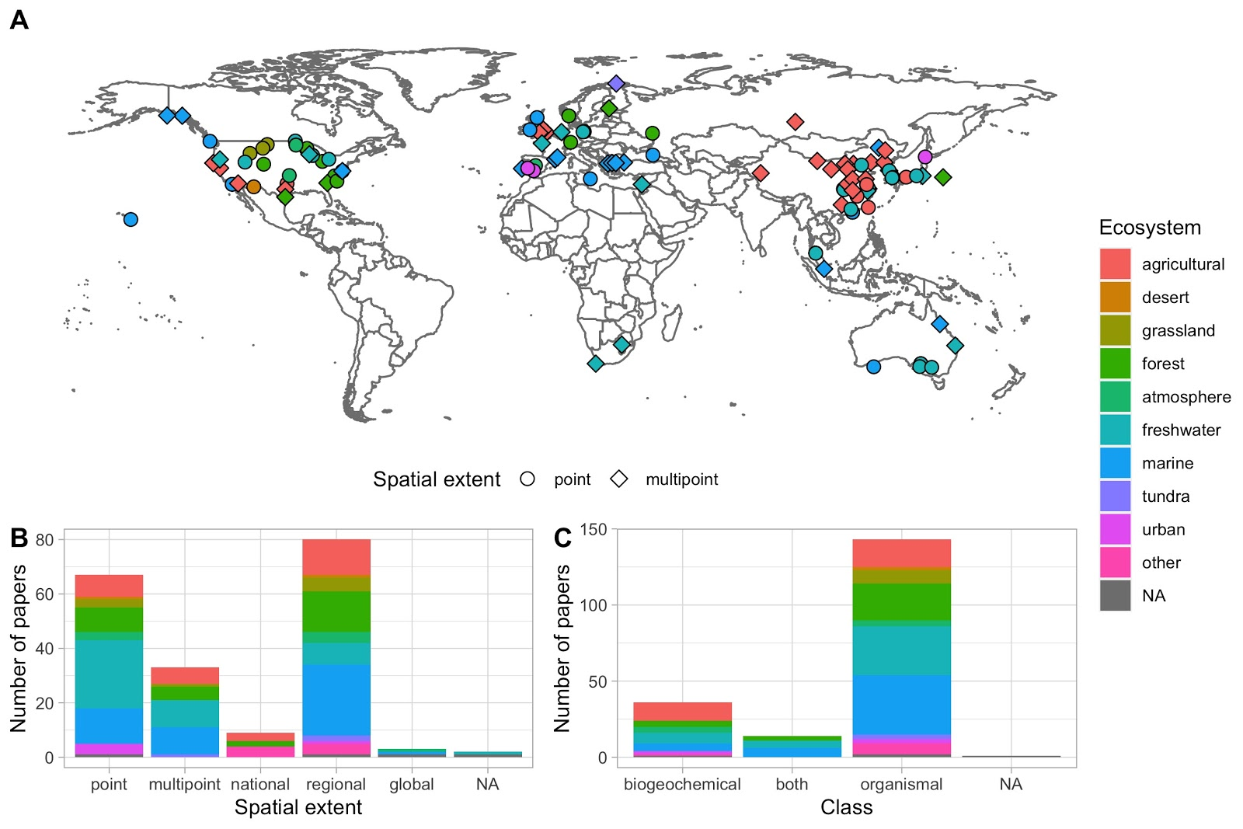
Figure X: General description of ecological forecasting papers identified. A: Map of all papers that can be localized to a single point on a map (circles) or multiple distinct points (diamonds). B: bar chart illustrating the spatial extent of the forecast for each paper. C: bar chart illustrating the class of the forecast variable for each paper. Fill colors illustrate ecosystem type.

Slide 4
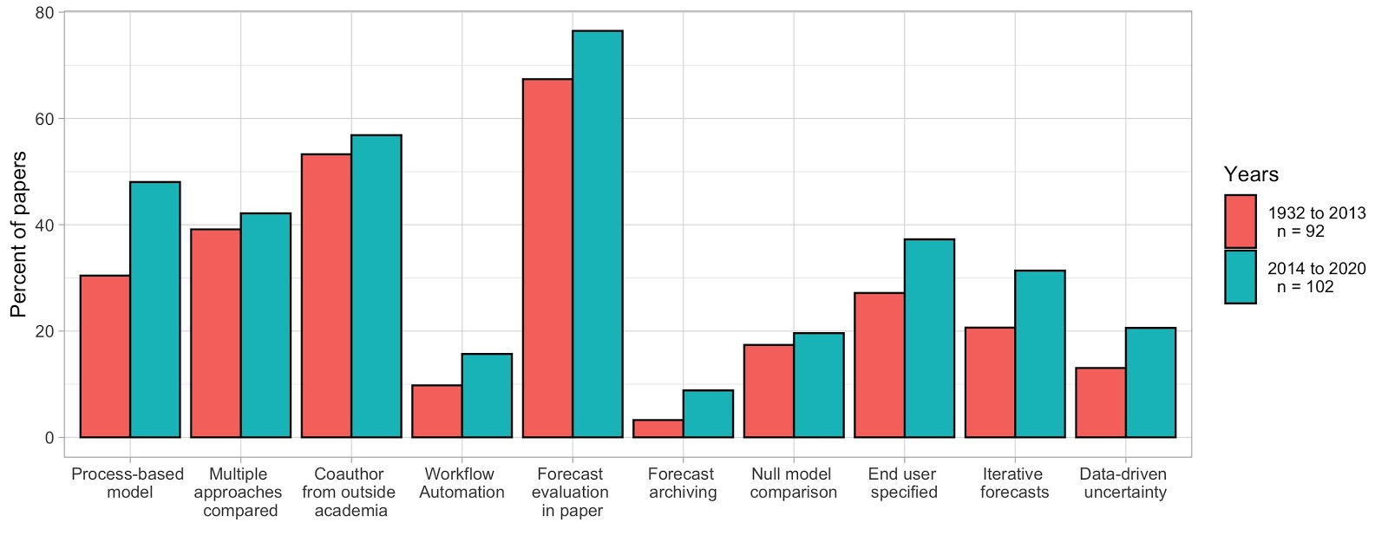
Figure Y: Bar chart illustrating the percent of papers analyzed that fit into each of 10 categories.

Slide 5
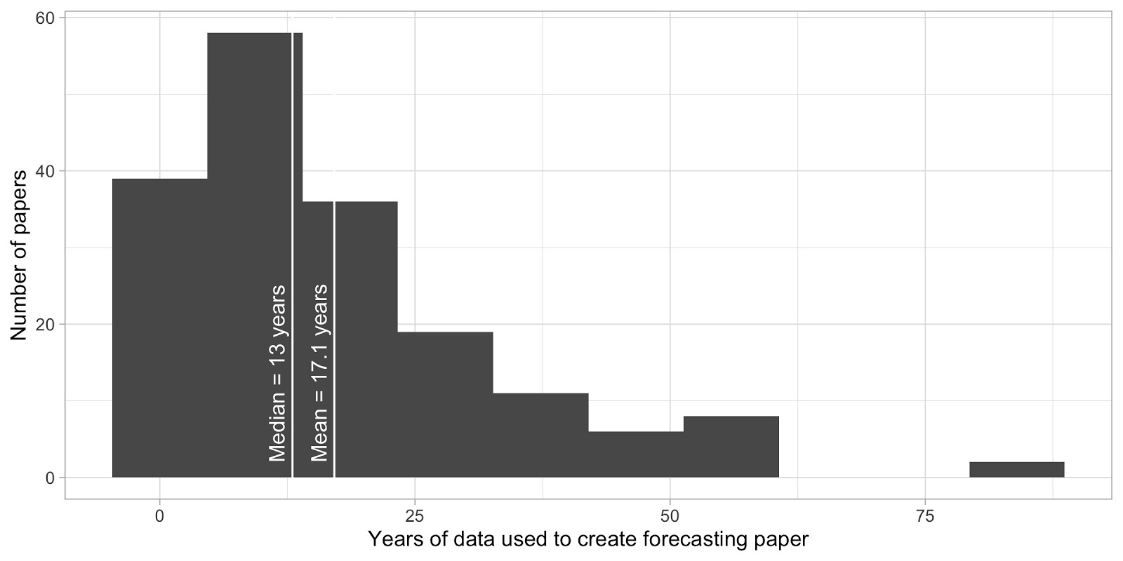
Figure Z: Histogram illustrating the number of years of data used in each forecasting paper

Slide 6
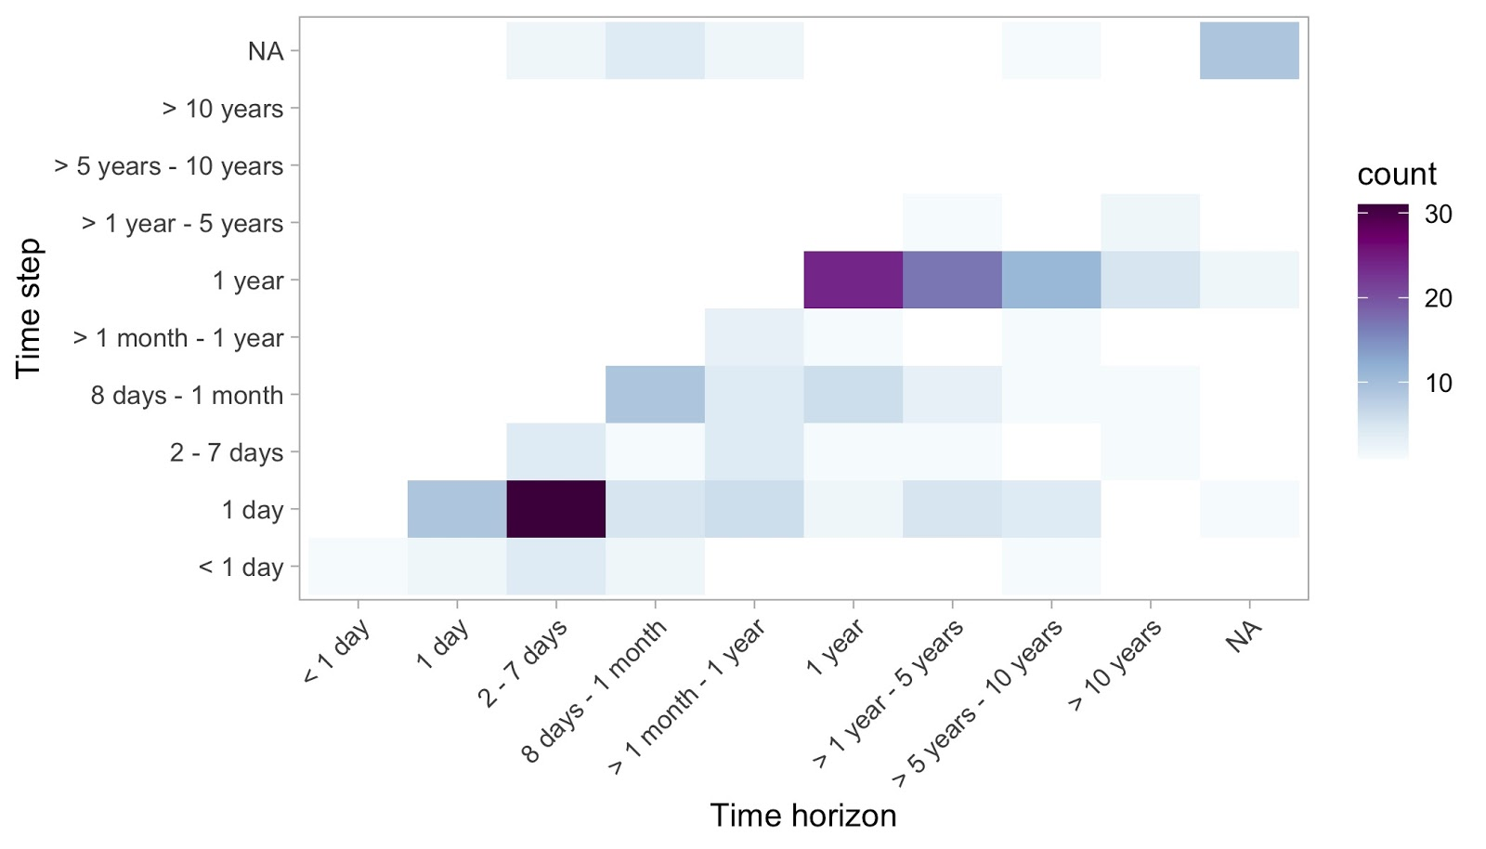
Figure A: Relationship between time step and time horizon of forecasting papers

Slide 7
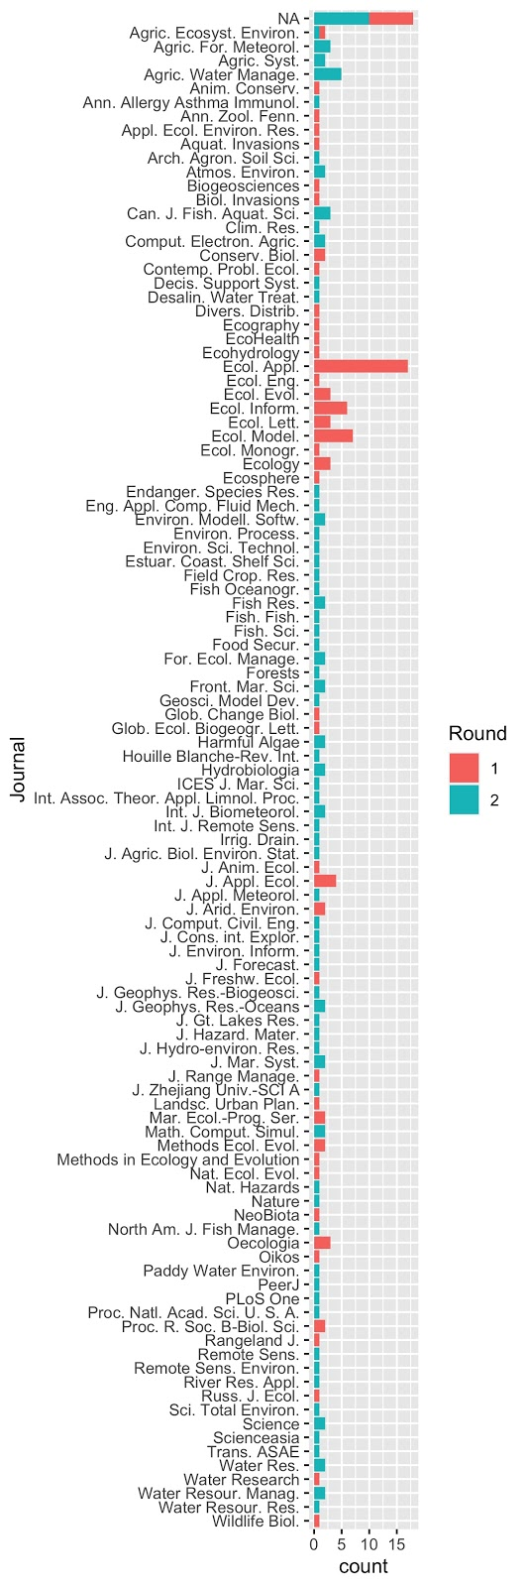
Figure B: 109 unique journals represented in this study. Ecological applications has the most (17 papers)

Slide 8
Analyzing predictability with R²
49 papers are identified as including R² (so far)
More papers could be included that report R, etc.
Analyze how R² varies with forecast horizon, time scale

Slide 9
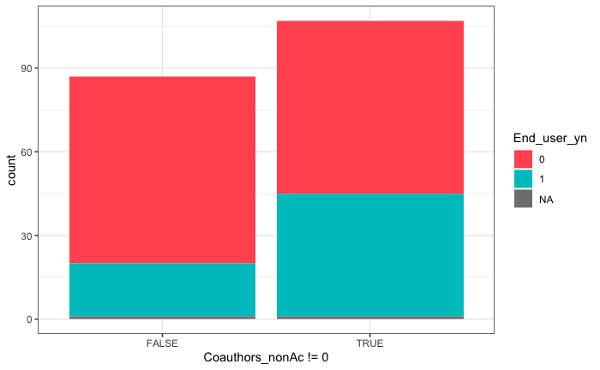

Slide 10
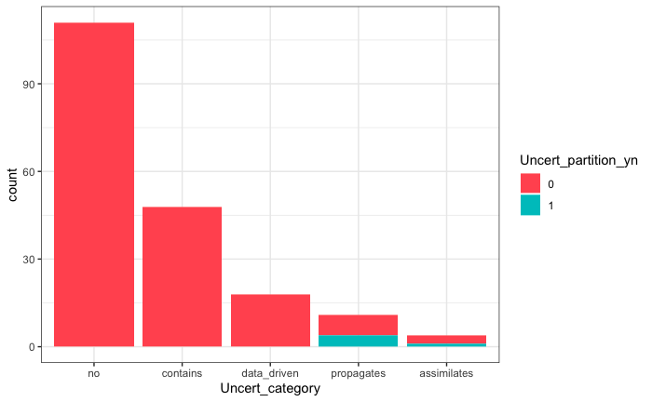

Slide 11
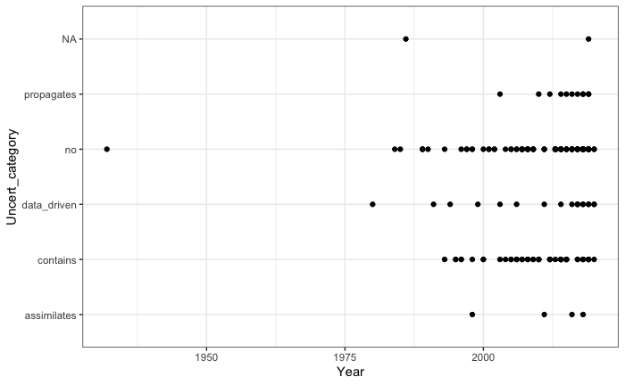

Slide 12
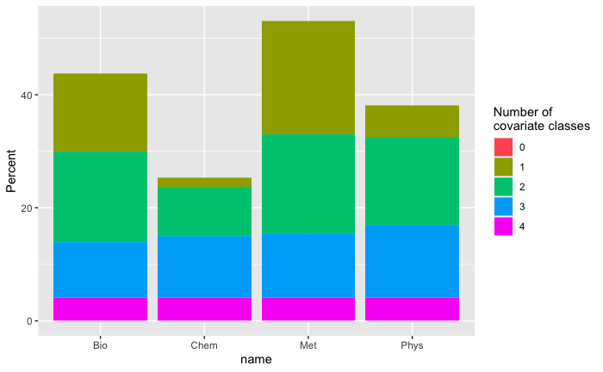

Slide 13
Re-screened papers
What percent of the time do reviewers agree:
whether it is a forecasting paper: 80%
# of non-academic coauthors: 71%
# of governmental coauthors: 57%
Time horizon: 57%
Time step = 66%
How often forecasts are made: 52%
Spatial scale (point/multipoint/regional): 62%
Ecosystem: 76%
Biogeochemical vs. organismal: 67%
Dimensions: 81%
Type (empirical vs process-based): 76%
Ensemble within model: 81%
Null model: 81%
Iterative: 71%
EFI uncertainty category: 57%
Forecast evaluation shown: 52%
Number of cycles evaluated 9.5%
physical covariate: 71%
chemical and meteorological: 90%
Biological covariate: 47%
Max and min driver latency: 52%
Partnership with stakeholder: 67%
Delivery method identified: 90%

Slide 14
Is it forecasting?
Unresolved questions here?

Slide 15
Coauthors
How have people been answering this question?
Do scientists from a research institute count as non-academic?

Slide 16
Spatial scale
Multipoint vs regional

Slide 17
Ecosystem
Evapotranspiration (ET)
Other questions here?

Slide 18
Biogeochemical vs organismal
Is this a useful distinction?
What characteristics make it one or the other

Slide 19
Time horizon, time step, and how often forecasts are made
What if there are multiple options in the paper

Slide 20
Model dimensions, type

Slide 21
EFI Uncertainty Category
no: This model does not contain this concept (e.g. model does not have random effects)
contains: The model contains this concept, but the input values are not derived from data (e.g. spin-up initial conditions, drivers are scenarios, hand-tuned parameters)
data_driven: The model contains this concept and the inputs are data driven (e.g. meteorological drivers, calibrated model parameters)
propagates: The model propagates uncertainty about this term
assimilates: The model iteratively updates this term through data assimilation
partitioning also!

Slide 22
Forecast evaluation shown
“Visually inspecting a graph”
Giving a list of predictions and observations (no statistics)

Slide 23
Number of cycles evaluated
Training data should not be counted here
Only one forecast horizon should be counted here (e.g., if the forecasts go out to 16 days, only include assessment metrics for 1 horizon)
Forecasting cycles that are not evaluated should not be included here (e.g., if the forecasting system has been producing forecasts for X years, but assessment metrics are only reported for 3 months within that time period, only report the cycles that are assessed)
If there are multiple forecast variables, give the answer for the SINGLE variable with the greatest number of forecasting cycles evaluated (this needs to be a forecast variable of interest; not a forecasted driver)
If multiple sites are used, add together the number of evaluated cycles at each site
This will typically equal the number of observations in the test period

Slide 24
Covariates
Make sure all categories are included here!
Does the forecasted variable count if data assimilation is used?

Slide 25
Next steps
Pairs for peer review
Peer review process
Review your own matrix
Make changes based on what we talked about today
Mark all of the things you have questions about (if not already marked)
It’s ok if this is a lot!
Review your partner’s questions
Message the group with any confusion
Abby | John
Whitney | Ryan
Cayelan | Dexter
Quinn | Nick
Heather | Rachel

